Slide 1
RPG CHARACTER CREATOR
Course project for CSCI 352
Ethan Buchanan and Steven Garcia-Alamilla

Slide 2
BACKGROUND
A role-playing game (RPG) is game in which players take on a role and assume a character in a fictional setting. Players can customize their character to be as unique as they want it, this includes :
Name
Appearance
Class
Race
Background
Skills
Abilities
The RPG Character Creator application is designed to provide an easy way to plan out future RPG journeys, whether you’re an RPG veteran or someone new to the genre, the RPG character creator will provide a fun and engaging way to customize your character.

Slide 3
APPROACH
In order to stay organized throughout the development stage, we implemented the use of two design patterns:
Builder Pattern, we can easily create complex objects (Characters in our case).The builder pattern offers the advantage of creating multiple types of objects using the same interface.
Factory Method, we can allow users to switch between different themes without affecting the functionality or structure of the application.

Slide 4
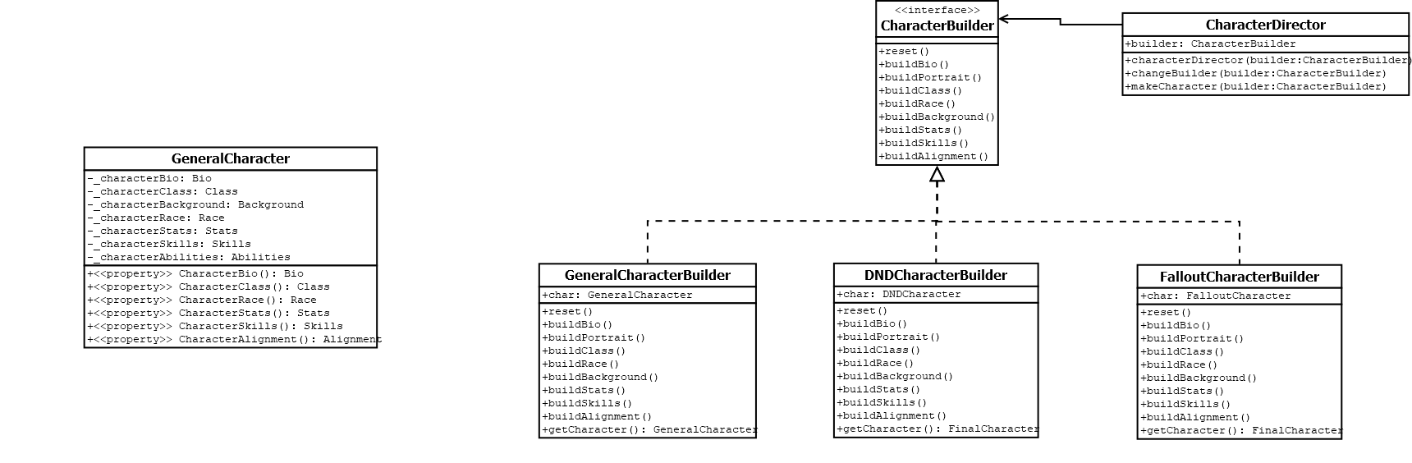
BUILDER DESIGN PATTERN UML FOR CHARACTER CREATION

Slide 5
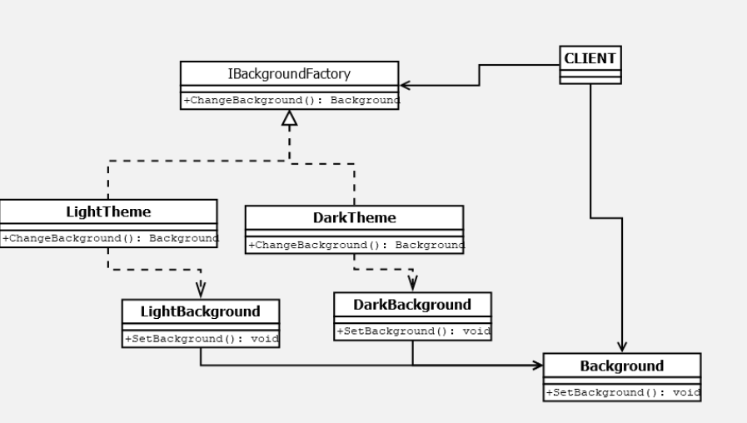
FACTORY METHOD FOR THEMES

Slide 6
FUTURE WORK
We plan on on adding more options for races, backgrounds, classes, alignment, skills, and abilities so that users can make their character as unique as they want it to be.
Fixing any major issues overall that are encountered.

Slide 7
DEMO
Clone the repository: https://github.com/ethcbuch/RPGCharacterCreator
Build the project
Run application

Slide 8
QUESTIONS OR FEEDBACK
Ethan Buchanan : etchbuch@ut.utm.edu
Steven Garcia-Alamilla: stegarc@ut.utm.edu

